Slide 1
Topics in Systems Engineering - IC Design
Detailed Routing
Shoukath Ali Mohammad
6819945

Slide 2
Index
Introduction to Detailed Routing
Constraints in Detailed Routing
Channel Routing
Switch Box Routing
Over the Cell Routing(OTC)
Summary
References

Slide 3
Introduction to Detailed Routing
Next to Global routing
Consider the routing regions one at a time
Detailed routing is finding the actual geometric layout paths
Layout of two different nets should not intersect on the same layer
Global Routing
Detailed Routing

Slide 4
Introduction to Detailed Routing
Terminology:
terminal
net
A
B
0
B
C
branch
tracks
trunk
C
C
A
A
0

Slide 5
Constraints in Detailed Routing
Horizontal Constraints
Vertical Constraints
Problem : The horizontal span of two terminals occupy common area
Solution : Each terminal should be assigned to separate tracks.
Horizontal Constraints
A
B
0
B
terminal
net
span
0
0
A
0

Slide 6
Constraints in Detailed Routing
: number of tracks.
Horizontal constraint graph
a b c d e f g h i j k :Column
net/vertex
S =
A
E
B
0
B
A
A
0
C
D
0
A
constraint/edge
A
B
E
B
C
E
D
D
C
C
0
A
B
E
C
D
0
0
B
C
Fig: HCG(undirected)
S(a) = {A,C}, S(b) = {A,C,E}, S(c) = {A,B,C,E}, S(d) = {A,B,C,E},
S(e) = {A,B,C,E}
S(f) = {A,B,C}, S(g) = {A,B,C,D}, S(h) = {B,C,D}, S(i) = {B,C,D},
S(j) = {B,C,D}, S(k) = {C}
Reference: Detailed routing by Andrew B. Kahng

Slide 7
Constraints in Detailed Routing
Vertical Constraints
Problem : When two terminals have pins in the same column.
Solution : Terminal on the top must be assigned a track above that of the lower terminal.
Vertical constraint graph
: assignment of order of nets to tracks.
net
A
E
B
0
B
A
A
0
C
D
0
A
terminal
edge
D
B
Reference: Detailed routing by Andrew B. Kahng
C
C
0
A
B
E
C
D
0
0
B
C
E
Reference: Detailed routing by Andrew B. Kahng
Fig: VCG(directed)

Slide 8
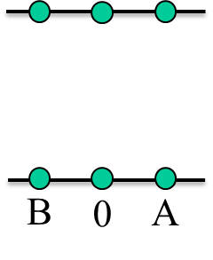
Constraints in Detailed Routing
Vertical Constraints
Problem : When two terminals have pins in the same column.
Solution : Terminal on the top must be assigned a track above that of the lower terminal.
A
B
B
A
B
B
A
B
B
0
A
Fig: VCG(directed)
Reference: Detailed routing by Andrew B. Kahng
Reference: Detailed routing by Andrew B. Kahng
Reference: Detailed routing by Andrew B. Kahng

Slide 9
Channel Routing
Channel Routing is a special case of detailed routing where pins are on either side of a channel and are routed on a horizontal routing region
Channel Routing Algorithms
Left-Edge Algorithm
Dogleg Routing Algorithm

Slide 10
Channel Routing
Channel Routing is a special case of detailed routing where pins are on either side of a channel and are routed on a horizontal routing region
Based on the VCG and the left-edge order
Left-edge order and VCG are used to determine the assignment order of terminals to tracks
HCG can be used to check no of tracks to be used
Only one horizontal segment is allowed to use by each terminal
Left-Edge Algorithm

Slide 11
Channel Routing
Left-Edge Algorithm example:
0
A
D
E
A
F
G
0
D
I
J
J
A
D
J
E
I
G
B
C
E
C
E
B
F
H
I
H
G
I
Reference: Detailed routing by Andrew B. Kahng
C
H
F
Generate VCG and Left-edge order
B
Reference: Detailed routing by Andrew B. Kahng
Left edge order = {B, A, C, D, E, F, G, H, I, J}
Fig : VCG

Slide 12
Channel Routing
Left edge order = {B, A, C, D, E, F, G, H, I, J}
0
A
D
E
A
F
G
0
D
I
J
J
A
D
J
1
E
I
G
2
3
C
H
F
4
5
B
Fig : VCG
B
C
E
C
E
B
F
H
I
H
G
I

Slide 13
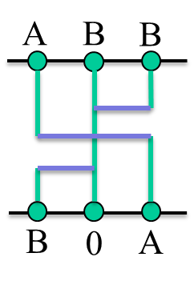
Channel Routing
Dogleg Routing Algorithm
Improving left-edge algorithm by net splitting
Two advantages:
Alleviate conflicts in VCG
Number of tracks can often be reduced
Net splitting
Dogleg
Reference: Detailed routing by Andrew B. Kahng

Slide 14
Channel Routing
A
A
A
B
B
0
A
A
B
B
0
B
0
B
0
C
C
C
(a) Channel routing problem
0
B
0
C
C
Reference: Detailed routing by Andrew B. Kahng
(b) VCG without net splitting
(c) Channel routing solution
Reference: Detailed routing by Andrew B. Kahng
Reference: Detailed routing by Andrew B. Kahng
A
A
B
B
0
A
A
B
B
0
A
A
B2
B1
B2
C
B1
C
0
B
0
C
C
0
B
0
C
C
(d) Net splitting
(e) VCG with net splitting
(f) Channel routing solution
Reference: Detailed routing by Andrew B. Kahng
Reference: Detailed routing by Andrew B. Kahng
Reference: Detailed routing by Andrew B. Kahng

Slide 15
Channel Routing
Example:
A
A
B
0
B
C
A
A
B1
B2
B
C
C1
C2
D
D
Fig : VCG(actual)
B
C
0
C
D
D
A
B2
C2
B1
C1
D
Fig : VCG(modified)

Slide 16
Channel Routing
Left edge order = {A, B1, C1, B2, C2, D}
A
B1,B2
B2
C2
A
A
B
0
B
C
B1
C1
B2
C2
B
C
0
C
D
D
B1
C1
C1,C2
D

Slide 17
Switch Box Routing
Pins on all four directions of a fixed-size grid based routing region
More complex than channel routing
Horizontal tracks or vertical columns can be assigned on a single layer
When routing fails new tracks are laid
Algorithm for switch box routing can be derived from channel routing algorithms
A horizontal track is automatically assigned to a pin on the left

Slide 18
Switch Box Routing
Example:
TOP = [0 D F H E C C]
LEFT = [A 0 D F G 0]
BOT = [0 0 G H B B H]
RIGHT = [B H A C E C]
(Reference: Detailed routing by Andrew B. Kahng)
Columns
a b c d e f g
0 D F H E C C
6 0
5 G
4 F
3 D
2 0
1 A
C
E
C
A
H
B
Tracks
0 0 G H B B H
Fig: Switchbox routing problem
Reference: Detailed routing by Andrew B. Kahng

Slide 19
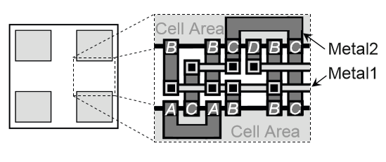
Over The Cell Routing
For routing more than three layers
Higher metal layers like Metal2 and Metal3 pins are used
Standard cells are not obstructed for these layers are not by the
Routing is performed on the entire chip area
Fig: OTC routing with two metal layers
Source: Detailed routing by Andrew B. Kahng

Slide 20
Over The Cell Routing
Chameleon OTC router
Developed by Braun et al.
Generates topologies for nets in either two or three metal layers
Minimise the total routing area
Assigns net segments to tracks
Ability to take into account technology parameters on a per layer basis
Designer can specify the wire width and the minimum distance between each wire segment for each layer
( Source: Detailed routing by Andrew B. Kahng)

Slide 21
Summary
Detailed routing is invoked after global routing
Horizontal and Vertical constraints must be satisfied by valid routes
Channels have net terminals on the two sides
Switch-boxes have terminals on four sides
Channels are joined as switchboxes
When the number of metal layers in greater than 3, use over the cell (OTC) routing

Slide 22
Reference
VLSI Physical Design: From Graph Partitioning to Timing Closure by Andrew B. Kahng, Jens Lienig, Igor L. Markov, Jin Hu

Slide 23
Thankyou for your attention
Shoukath Ali Mohammad
6819945

